Slide 1
Core Spring

Slide 2
Overview Of The Spring Framework
Chapter 1

Slide 3
Objectives
Describe the forces that produced Spring
Define the Spring Framework
Explain what Spring is used for
Discuss why Spring is successful
Explain where it fits in your world

Slide 4
Chapter Topics
The Forces That Led To Spring
What Is Spring?
Spring Is A Container
What Is Spring Used For?
Summary
References
Review
Lab

Slide 5

Problems In Enterprise Computing (1 Of 2)
Consider a hypothetical job interview for a position as a “Bank Application” developer
  What type of skills would you expect of an applicant for this position?

Slide 6
Problems In Enterprise Computing (2 Of 2)
Bank Application Developer skill set:
  An understanding of the problem domain
  Transaction management
  Security
  Database access
  Remote communication
What is problematic about these expectations?
  Only 1 of the 5 stated requirements addresses the problem domain directly
  4 of the 5 requirements are about supporting infrastructure, which while important, should be isolated from the problem domain itself
  You shouldn't have to modify application code to replace a database vendor, because your business rules don't change
    It makes the code less portable

Slide 7
Application Servers To The Rescue
Historically how has industry responded to this need to separate domain specific code from infrastructure code?
  Application Server Technology
    Separates business logic from the underlying infrastructure on which the logic depends, so that each can change independently of the other, resulting in greater portability
Business Logic
X
Supporting Infrastructure
Supporting Infrastructure

Slide 8
The Fly In The Ointment
Unfortunately, initial implementations of Application Server technology failed to provide this “holy grail” of separation / portability
  Proprietary implementations
    Each vendor's implementation has differed from its competitors in ways that have tended to permeate the codebase
  Changing from one vendor's implementation of an Application Server to another required extensive code modification, defeating the whole point of the exercise; to isolate the infrastructure from the codebase

Slide 9
Java Enterprise Edition (JEE) To The Rescue
In an effort to address this lack of portability among Application Server products in the Java world, Sun Microsystems organized an industry-wide consortium, responsible for developing a standard for portable, Java-based Application Server products
  Called Java Enterprise Edition

Slide 10
The Good News
Java Enterprise Edition defined a reasonably portable standard for developing applications and application components that could be ported from one JEE vendor to another without extensive code modification

Slide 11
The Bad News
Unfortunately, Java Enterprise Edition (particularly a central component of JEE, Enterprise JavaBeans) came with its own baggage
  Bloat
    JEE could be overkill for many enterprise needs
    All or nothing proposition
  Complexity
    There were many pieces to JEE that needed to be understood and mastered in order to get many of the benefits the framework had to offer
  Poor design choices
    Some parts of the API didn't make a lot of sense
      e.g. Why did you have to provide a passivation method to a stateless session bean, when a stateless session bean could not be passivated?
  Tight coupling to the framework APIs
    Extension of JEE classes
    Implementation of JEE interfaces
  Tight coupling to the framework's runtime environment
    The need for an application server in order to run a unit test
  Expensive to operate

Slide 12
Spring To The Rescue
A gentleman by the name of Rod Johnson, a JEE consultant, became frustrated with use of JEE in many projects for which he felt the platform was ill suited
  Give a child a hammer ...
Johnson and a colleague, Juergen Hoeller started looking for alternative ways to deliver the functionality of JEE in a lightweight framework
  The result was Spring
  Released in 2004
  Introduced in Johnson's Book “J2EE Development without EJB”

Slide 13
Chapter Topics
The Forces That Led To Spring
What Is Spring?
Spring Is A Container
What Is Spring Used For?
Summary
References
Review
Lab

Slide 14
What Is Spring?
Spring is an Open Source, lightweight, container and framework that, like JEE, provides comprehensive infrastructure support for developing Java-based enterprise applications
  Spring deals with the plumbing
  So you can focus on the problem domain
  In a consistent manner
  Think of Spring as an application harness into which you plug components in standard ways in order to assemble those applications

Slide 15
An Analogy
Imagine that you are the manufacturer of a car
Your car is available with dozens of options, combinable in hundreds of permutations
You want to make it as easy as possible to manufacture the car, regardless of the combination of options the customer requires
So you build the car to a standard specification into which any of the options can easily be integrated

Slide 16
How Does This Differ From What JEE Offers?
Spring was developed specifically to address some of the major difficulties associated with JEE
  Bloat
    Spring is not a server, though it provides services often found in server products
      It has been engineered to provide the features of a server in ways that are
        Lightweight
        Configurable
        Extensible
        Optional
    Analogize Spring to a budget airline on which you pay only for what you use, with JEE more like a full service airline for which you might pay for services you don't need
  Complexity
    Spring is POJO based
      No need to master a complex suite of APIs
  Tight coupling to the framework APIs
    Spring classes/interfaces are largely transparent to your codebase
  Tight coupling to a framework's runtime environment
    Lacking a server, Spring components can be tested independently of a server environment

Slide 17
Key Features (1 Of 2)
Open Source under the Apache 2 license
  Source available at:
    https://github.com/spring-projects/spring-framework
  Binaries available at:
    http://mvnrepository.com/artifact/org.springframework
  Documentation available at:
    http://docs.spring.io/spring/docs/current/spring-framework-reference/htmlsingle/
Lightweight
  Spring does not require an application server
  Your Spring beans are just POJOs
  Few overt dependencies on Spring classes/interfaces, making it easier to migrate code into or out of the framework
  The Spring jar files used in this course are < 8MB in size

Slide 18
Key Features (2 Of 2)
A factory container
  Manufacturing application components, and wiring them together in ways that are isolated/externalized from the rest of the application
  Making it possible to reconfigure applications and the components they depend on, without modifying the applications or components themselves
A framework
  Providing infrastructure classes to standardize and simplify component integration with external resources and technologies

Slide 19
The Spring Triangle
Dependency Injection
  A style of programming that allows component dependencies to be established in ways that are loosely coupled (and thereby easily reconfigurable)
Aspect Oriented Programming
  A style of programming that allows services to be associated with components in ways that are loosely coupled (and thereby easily reconfigurable)
Enterprise Service Abstractions
  A uniform approach toward separating application services from the infrastructure on which they depend

Slide 20
Chapter Topics
The Forces That Led To Spring
What Is Spring?
Spring Is A Container
What Is Spring Used For?
Summary
References
Review
Lab

Slide 21
Application Configuration
A typical application system consists of several parts working together to carry out a use case
Transfer
Service
Transfer
Repository
Account
Repository

Slide 22
Example: Money Transfer System
TransferService
AccountRepository
transfer(
“300.00”,
“1”, “2”)
loadAccount(“1”);
new
a1
Account 1
loadAccount(“2”);
a2
new
Account 2
debit(“300.00”)
credit(“300.00”)
updateAccount(a1);
updateAccount(a2);
confirmation

Slide 23
Spring's Configuration Support
Spring provides support for assembling such an application system from its parts
  Parts do not worry about finding each other
  Any part can easily be swapped out

Slide 24
Money Transfer System Assembly
How do you get a factory to create and assemble the pieces of an application, in the right order?
Spring
Part 2
TransferServiceImpl
Assembly
JdbcAccountRepository
Part 1
(1) repository = new JdbcAccountRepository(…);
(2) service = new TransferServiceImpl();
(3) service.setAccountRepository(repository);

Slide 25
Parts Are Just Plain Old Java Objects (POJOs)
By implementing the parts of the system as POJOs, rather than as extensions of container specific components
public class JdbcAccountRepository implements AccountRepository {
…
}
Part 1
Implements a service/business interface
public class TransferServiceImpl implements TransferService {
private AccountRepository accountRepository;
public void setAccountRepository(AccountRepository ar) {
accountRepository = ar;
}
…
}
Part 2
Depends on the interface
Conceals complexity of implementation
Allows for swapping out implementation

Slide 26
Swapping Out Part Implementations
Which makes it easy to swap one component for another when, for example, switching from development mode to test mode
Spring
TransferServiceImpl
JpaAccountRepository
StubAccountRepository
JdbcAccountRepository
For JDBC
For Unit Testing
new StubAccountRepository();
new TransferServiceImpl();
service.setAccountRepository(repository);

Slide 27
Using A Layered Architecture
Examples in this course assume a three-layered architecture consisting of
  Service (application) layer
    Exposes high-level application functions
    Business logic defined here
  Data access layer
    Defines the interface to the data repository
    In ways that are decoupled from the repository implementation
  Infrastructure layer
    Exposes low level services to other layers
Separation of concerns
Service
Layer
Data Access
Layer
Infrastructure
Layer

Slide 28
Chapter Topics
The Forces That Led To Spring
What Is Spring?
Spring Is A Container
What Is Spring Used For?
Summary
References
Review
Lab

Slide 29
What Is Spring Used For
Spring is used to build enterprise applications dealing with
Web Interfaces
Messaging
Persistence
Batch
Integration

Slide 30
The Current World
Originally considered a “complement” to JEE, Spring has evolved to be remarkably flexible and scalable, considered by many to be an alternative to JEE
Spring continues to innovate
  Web
    AJAX, WebSockets, REST, Mobile, Social
  Data
    NoSQL, Big Data, Stream processing
  Cloud
    Distributed systems, Cloud, Microservices
  Productivity
    Spring Boot, Spring Cloud Data Flow

Slide 31
What Services Can You Expect From The Spring Framework?
Application Configuration (Dependency Injection)
Aspect Orientation (Aspect Oriented Programming)
Testing Support
Enterprise Integration (Enterprise Service Abstractions)
  Database Access
  Transaction Management
  Messaging
  Web Application
  Web Service
  Remote Access
  Management/Monitoring Extensions
  Caching
  Application Server Support
  Scheduling
  Email
Framework Extensions

Slide 32
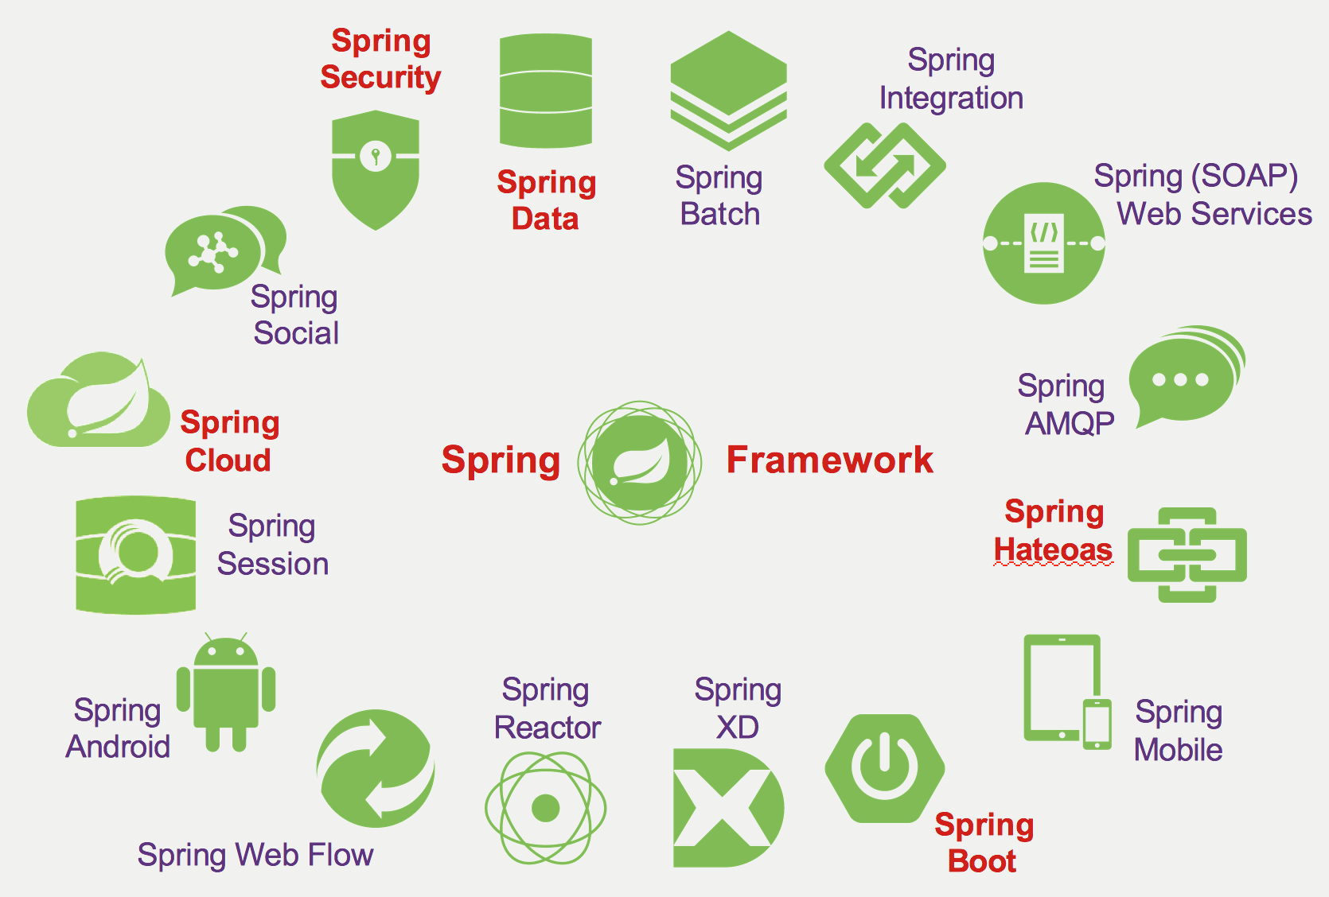
Spring Projects (1 Of 4)

Slide 33
Spring Projects (2 Of 4)
http://spring.io/projects
Spring Android
  Simplifies the development of Android applications
Spring AMQP
  Applies core Spring concepts to the development of AMQP-based messaging solutions
Spring Batch
  A lightweight, comprehensive batch processing framework
Spring Boot
  Gets applications up and running as quickly as possible
Spring Cloud
  Provides tools for developers to quickly implement common patterns in distributed systems
Spring Data
  Provides a consistent, Spring-based programming model for data access, regardless of the underlying data store
Spring HateOAS
  Simplifies the development of REST applications modeled on HATEOAS principles

Slide 34
Spring Projects (3 Of 4)
http://spring.io/projects
Spring JMS
  Applies core Spring concepts to the development of JMS-based messaging solutions
Spring JMX
  Transparently integrates Spring applications into a JMX infrastructure
Spring Integration
  Provides a simple model for building enterprise integration solutions while maintaining the separation of concerns essential for producing maintainable, testable code
Spring LDAP
  Simplifies the development of applications that employ LDAP
Spring MVC
  Brings the benefits of the Spring platform to web application development
Spring Mobile
  Simplifies the development of mobile web applications
Spring Reactor
  A set of tools to compose applications in ways that use system resources efficiently

Slide 35
Spring Projects (4 Of 4)
http://spring.io/projects
Spring Remoting
  Simplifies the development of remote-enabled services, regardless of the remoting technology
Spring Security
  A powerful, highly customizable authentication and access-control framework
Spring Session
  A platform for managing user session information
Spring Social
  Connects your applications to external service providers like Facebook, Twitter and LinkedIn
Spring Web Flow
  Simplifies the development of web applications with complex state and navigational requirements
Spring Web Services
  Facilitates the development of SOAP, contract-first web services
Spring XD
  Simplifies the development of big data applications

Slide 36
Spring Framework History
Spring 2.0 (2006)
  XML simplification, async JMS, JPA, AspectJ support
Spring 2.5 (2007, currently 2.5.6)
  Requires Java 1.4+ and supports JUnit 4
  Annotation DI, @MVC controllers, XML namespaces
Spring 3.x (3.2 released Dec 2012)
  Environment & Profiles, @Cacheable, @EnableXXX ...
  Requires Java 1.5+ and JUnit 4.7+
  REST support, JavaConfig, SpEL, more annotations
Spring 4.x (released Dec 2013)
  Support for Java 8, @Conditional, Web-sockets
Spring 5.x (2017)
  Reactive programming focus

Slide 37
Chapter Topics
The Forces That Led To Spring
What Is Spring?
Spring Is A Container
What Is Spring Used For?
Summary
References
Review
Lab

Slide 38
Summary
Spring is an Open Source, lightweight, container and framework that, like JEE, provides comprehensive infrastructure support for developing Java-based enterprise applications
The Spring Triangle captures 3 key features of the Spring framework
  Dependency Injection
  Aspect Oriented Programming
  Enterprise Service Abstractions

Slide 39
Chapter Topics
The Forces That Led To Spring
What Is Spring?
Spring Is A Container
What Is Spring Used For?
Summary
References
Review
Lab

Slide 40
References
SpringFramework.org
  Reference manual
Forum.SpringSource.org
  Each forum is moderated by the project lead for that particular Spring project
STS IDE Dashboard
javaranch.com
refcardz.dzone.com
www.infoq.com
  Video presentations
STS Media Blog
Spring in Action – Craig Walls
Java2s.com
Java4s.com
Spring.io

Slide 41
Chapter Topics
The Forces That Led To Spring
What Is Spring?
Spring Is A Container
What Is Spring Used For?
Summary
References
Review
Lab

Slide 42
Review
What is the primary objective of Application Server technology?

Slide 43
Review Answer
What is the primary objective of Application Server technology?
  To separate business logic from the underlying infrastructure on which the logic depends, so that each can change independently of the other

Slide 44
Review
What prevented early versions of Application Server technology from achieving the “holy grail” of portability?

Slide 45
Review Answer
What prevented early versions of Application Server technology from achieving the “holy grail” of portability?
  Proprietary implementations

Slide 46
Review
What problems have limited the acceptance of JEE in the Java community?

Slide 47
Review Answer
What problems have limited the acceptance of JEE in the Java community?
  Bloat
  Complexity
  Tight coupling to the standard
  Tight coupling to the framework

Slide 48
Review
How does Spring address the problems that have limited the acceptance of JEE in the Java community?

Slide 49
Review Answer
How does Spring address the problems that have limited the acceptance of JEE in the Java community?
  Bloat
    Spring was designed to provide the features of a server in ways that are
      Lightweight
      Configurable
      Extensible
      Optional
  Complexity
    Spring is POJO based
  Tight coupling to the framework APIs
    Spring classes / interfaces are largely transparent to your codebase
  Tight coupling to the framework's runtime environment
    Lacking a server, Spring components can be tested independently of a server environment

Slide 50
Review
Describe the 3 features that characterize the Spring Triangle

Slide 51
Review Answer
Describe the 3 features that characterize the Spring Triangle
  Dependency Injection
    A style of programming that allows component dependencies to be established in ways that are loosely coupled (and thereby easily reconfigurable)
  Aspect Oriented Programming
    A style of programming that allows services to be associated with components in ways that are loosely coupled (and thereby easily reconfigurable)
  Enterprise Service Abstractions
    A uniform approach toward separating application services from the infrastructure on which they depend

Slide 52
Chapter Topics
The Forces That Led To Spring
What Is Spring?
Spring Is A Container
What Is Spring Used For?
Summary
References
Review
Lab

Slide 53
Lab
Chapter 1: Introduction to Core Spring
  Eclipse Project
    01-spring-intro
  Instructions
    spring-intro-lab.html
  Completion Time
    45 minutes

